Slide 1

TAAR
Session 2022-2023
Presented by: Jayant Tailor , Gaurav Ameta , Manish Vyas , Himanshu Vaishnav , Kharol Yash
DEPARTMENT OF COMPUTER SCIENCE ENGINEERING
VIDYA BHAWAN POLYTECHNIC COLLEGE UDAIPUR(RAJ.)

Slide 2
TITLE OF THE PROJECT :-
TAAR
OBJECTIVE OF THE PROJECT :-
Nowadays, Communication is very important in this time . For Communicate or sharing data information or to send any information regarding as company , office , School and important documents . In this cases information can be lost .
The purpose of this project is to reduce the hardwork and especially in areas like school , college like where teachers have to assign work to students and if they are not coming by any reason so they can send work directly with their phone and any important information regarding etc .
So to reduce this hardwork and the data lost problems we will build this Chat Application . So, they won't have to worry about it and their information will be safe .

Slide 3
Scope of Project :-
The Scope of the Project is help the user to communicate with chat application to send information , message and etc and also entertainment by group chats .
Features of our Project:-
Provides private chats between two person
Provides group chats
Reduce the hardwork to send message directly
Also use for entertainment purpose

Slide 4
Methodology
Mern Stack
MERN stands for MongoDB, Express, React, Node, after the four key technologies that make up the stack.
MongoDB — document database
Express(.js) — Node.js web framework
React(.js) — a client-side JavaScript framework
Node(.js) — the premier JavaScript web server

Slide 5
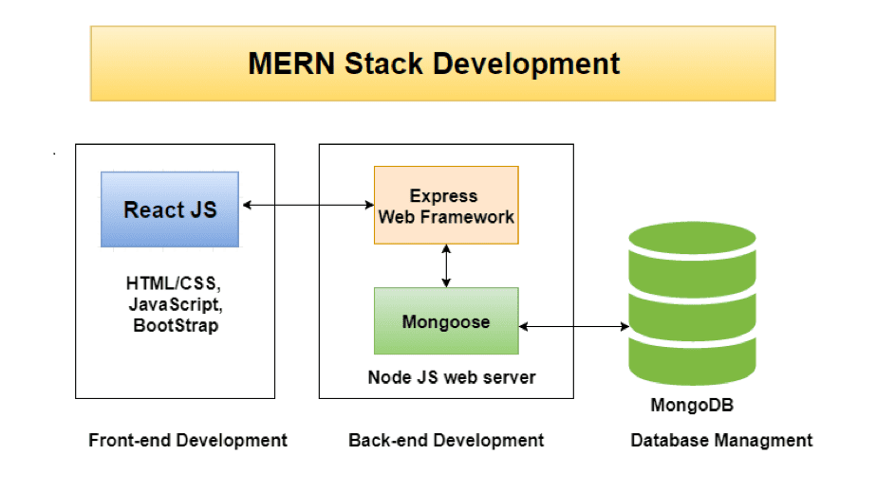

Slide 6
REACT JS
ReactJS is a declarative, efficient, and flexible JavaScript library for building reusable UI components.
The main objective of ReactJS is to develop User Interfaces (UI) that improves the speed of the apps. It uses virtual DOM (JavaScript object), which improves the performance of the app.
The JavaScript virtual DOM is faster than the regular DOM. We can use ReactJS on the client and server-side as well as with other frameworks.

Slide 7
Express.js and Node.js server tier
The next level down is the Express.js server-side framework, running inside a Node.js server.
Express.js bills itself as a“ fast, unopinionated, minimalist web framework for Node.js,” and that is indeed exactly what it is.
Express.js has powerful models for URL routing (matching an incoming URL with a server function), and handling HTTP requests and responses.

Slide 8
MongoDB Database Tier
MongoDB is an open-source document database and leading NoSQL database. MongoDB is written in C++.
This tutorial will give you great understanding on MongoDB concepts needed to create and deploy a highly scalable and performance-oriented database.

Slide 9
Chakra UI
Chakra UI is a component-based library. It's made up of basic building blocks that can help you build the front-end of your web application.
It is customizable and reusable, and most importantly it supports ReactJs, along with some other libraries too.
Chakra UI is extremely simple to use, especially when you are familiar with how to use ReactJs components.

Slide 10
JSON Web Token (JWT)
A JSON web token(JWT) is JSON Object which is used to securely transfer information over the web(between two parties).
It can be used for an authentication system and can also be used for information exchange.The token is mainly composed of header, payload, signature.
Socket I.O
Socket.IO enables real-time bidirectional event-based communication. It works on every platform, browser or device, focusing equally on reliability and speed.
Socket.IO is built on top of the WebSockets API (Client side) and Node.js. It is one of the most depended upon library on npm (Node Package Manager).

